Slide 1
Agentic RAG Chatbot for Multi-Format Document QA
Author: Rohith Kumar
Email: rohitofficial9989@gmail.com
Phone: 7702295908

Slide 2
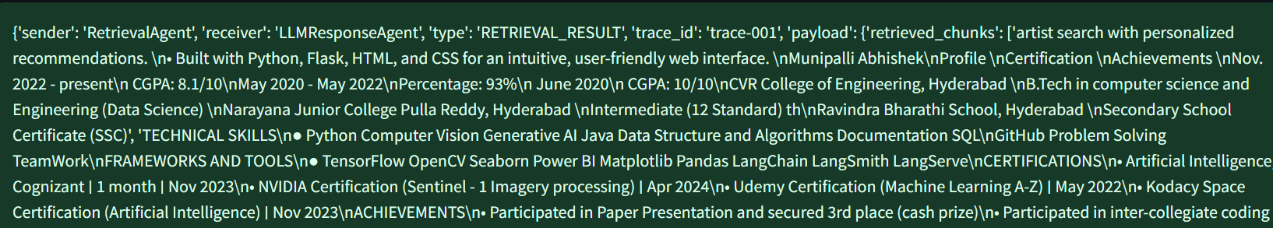
Agent-Based Architecture with MCP
IngestionAgent: Parses & preprocesses documents.
RetrievalAgent: Embeds text, builds FAISS store, semantic retrieval.
LLMResponseAgent: Forms final prompt, calls Groq LLM for answers.
Coordinator: Orchestrates MCP messages.
Example MCP Message

Slide 3
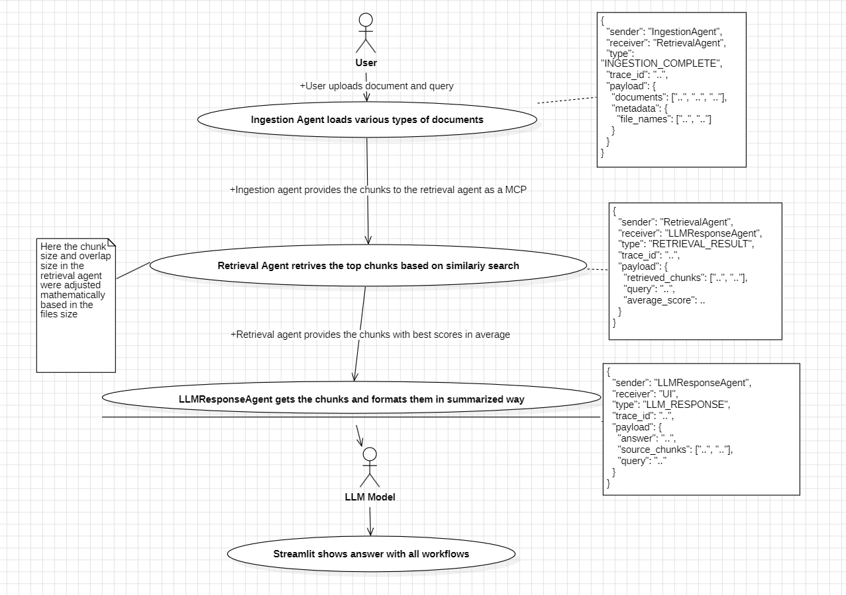
System Flow with MCP Messaging

Slide 4
Tech Stack Used
Python + LangChain
HuggingFace Embeddings
FAISS Vector Store (Langchain)
Groq LLM (deepseek-r1-distill-llama-70b) (Langchain)
Streamlit for Chatbot UI

Slide 5
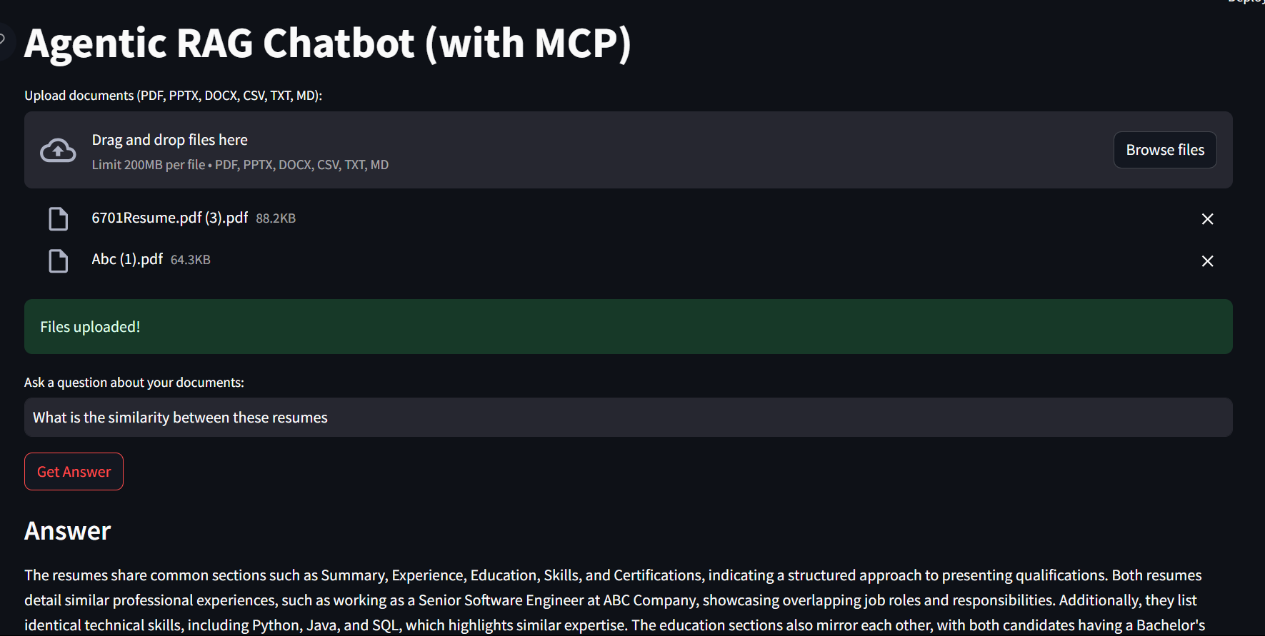
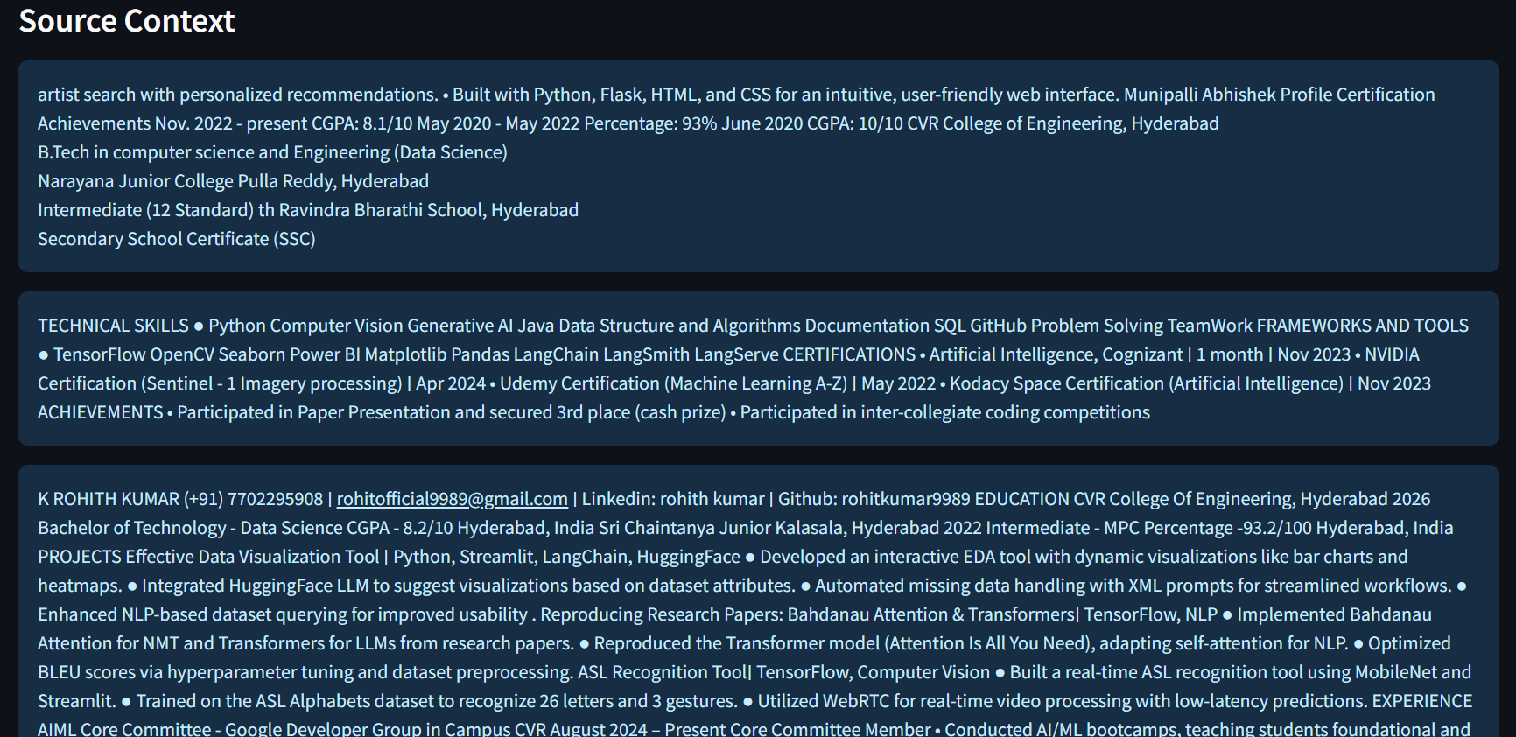
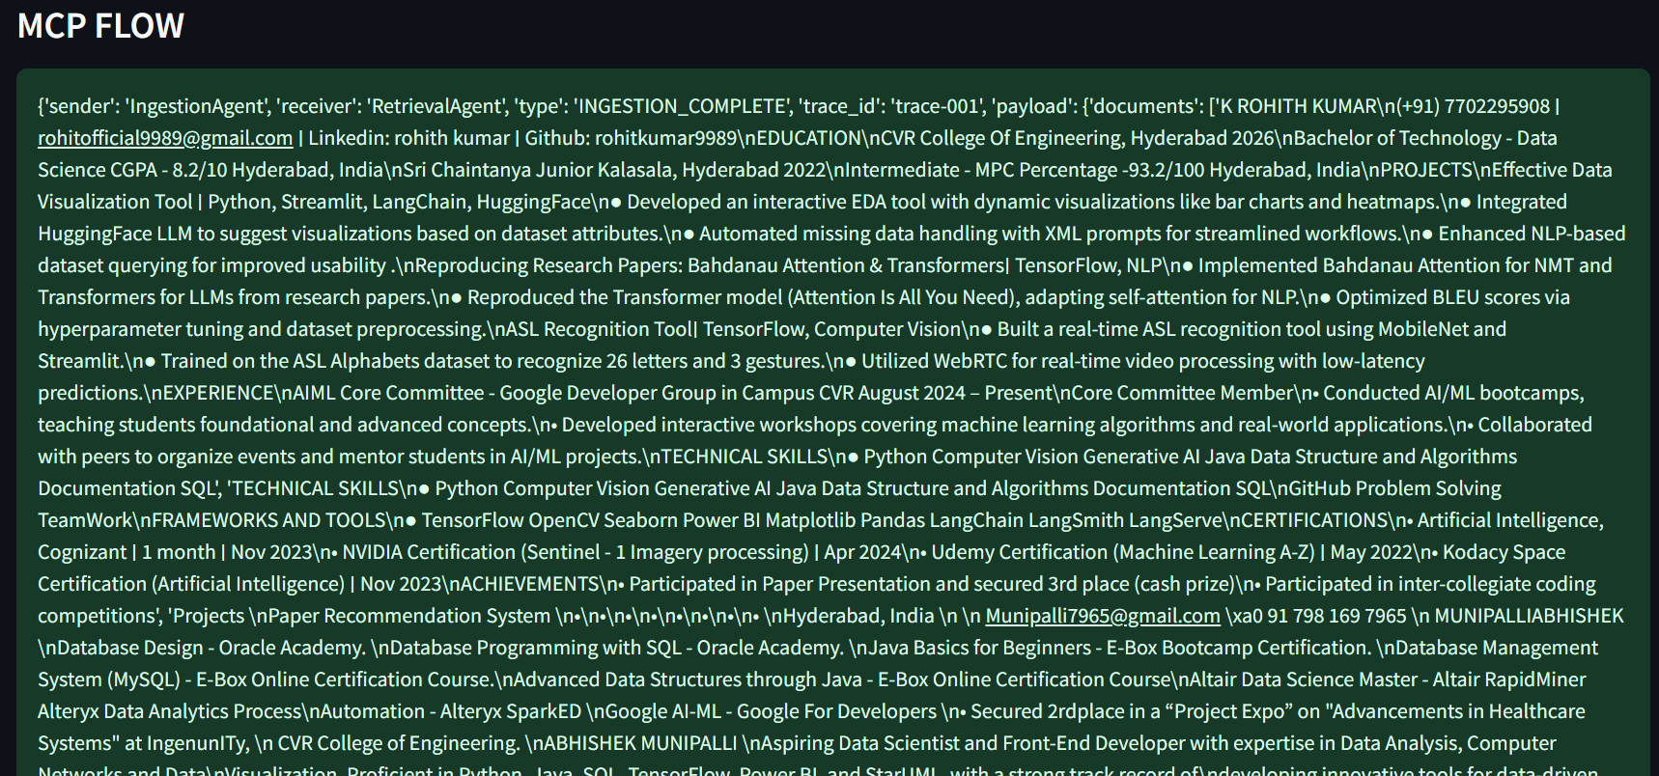
UI Screenshots

Slide 6
Challenges & Future Improvements
Challenges Faced:
Adding chat history directly to prompts was inefficient and hard to maintain.
Switching to RunnableWithMessageHistory made session-based multi-turn chat easier.
Handling multiple document formats & chunk sizes.
Securing API keys for HuggingFace and Groq LLM.
Future Scope:
Persist vector store for faster reuse.
Migrate to LangGraph for better agent orchestration.
Add user authentication and feedback loop.

